Slide 1
Classification
Logistic Regression

Slide 2

Classification
Email: Spam / Not Spam?
Online Transactions: Fraudulent (Yes / No)?
Tumor: Malignant / Benign ?
0: “Negative Class” (e.g., benign tumor)
1: “Positive Class” (e.g., malignant tumor)

Slide 3

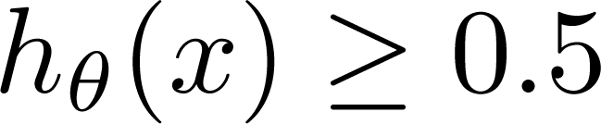
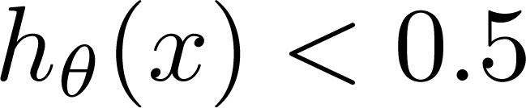
(Yes) 1
Malignant ?
(No) 0
Tumor Size
Tumor Size
Threshold classifier output at 0.5:
If , predict “y = 1”
If , predict “y = 0”

Slide 4

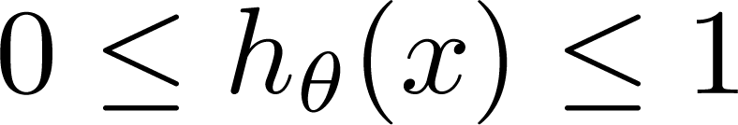
Classification: y = 0 or 1
can be > 1 or < 0
Logistic Regression:

Slide 5
Hypothesis Representation (How the function will look like?)
Logistic Regression

Slide 6
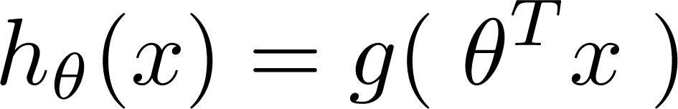
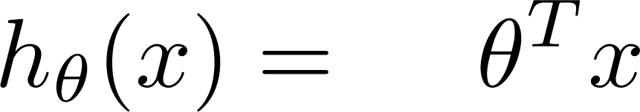
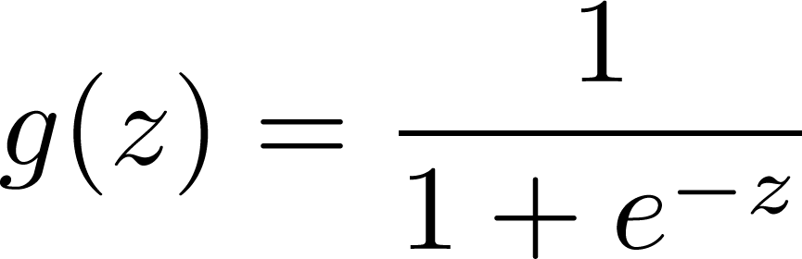
Logistic Regression Model
Want
1
0.5
Sigmoid function
Logistic function
0

Slide 7
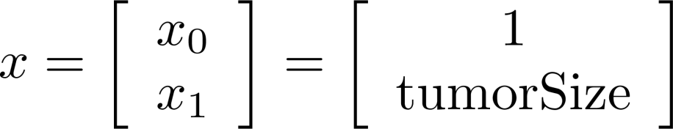
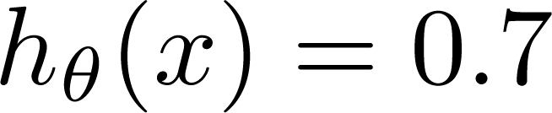
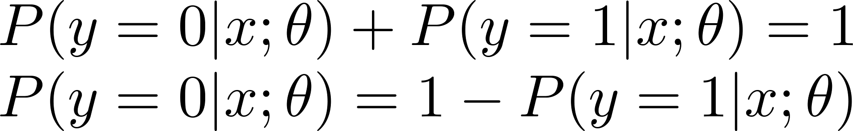
Interpretation of Hypothesis Output
= estimated probability that y = 1 on input x
Example: If
Tell patient that 70% chance of tumor being malignant
“probability that y = 1, given x,
parameterized by ”

Slide 8
Decision Boundary (Talking about the decision boundary will give us a better sense of what the logistic regression hypothesis function is computing.)
Logistic Regression

Slide 9


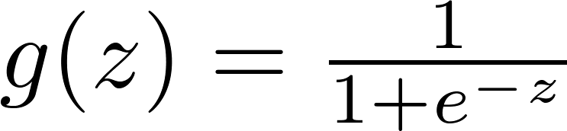

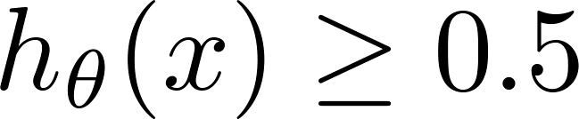

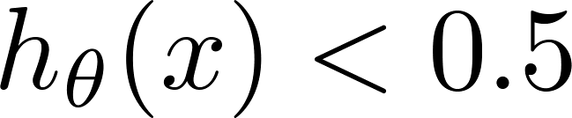
Logistic regression
1
z
Suppose predict “ “ if
predict “ “ if
Let's use this to better understand how the hypothesis
of logistic regression makes those predictions.

Slide 10
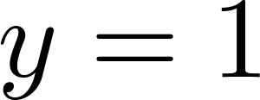

Decision Boundary
x₂
3
2
1
1
2
3
x₁
Predict “ “ if

Slide 11
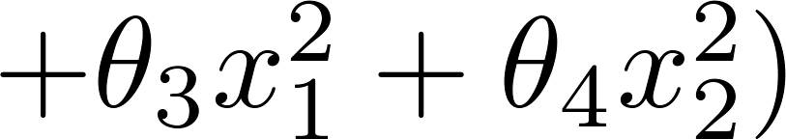
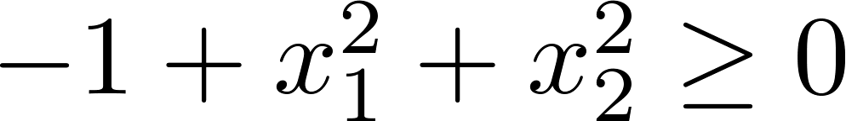
Non-linear decision boundaries
x₂
1
x₁
-1
1
-1
Predict “ “ if
x₂
x₁
So with these visualizations, I hope that gives you a what's the range of hypothesis functions we can represent using the representation that we have for logistic regression.

Slide 12
Now that we know what h(x) can represent.
Next: see how to automatically choose the parameters theta.
So that given a training set we can automatically fit the parameters to our data.

Slide 13
Cost Function
Logistic Regression

Slide 14
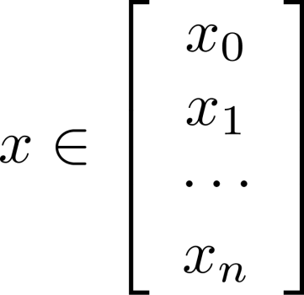

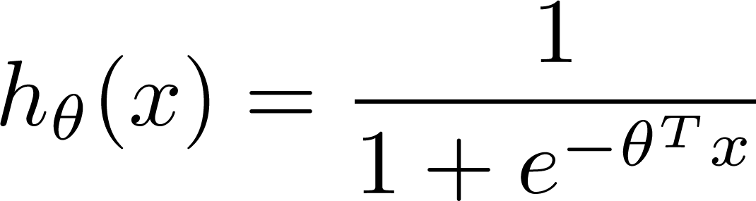

Training set:
m examples
How to choose parameters ?

Slide 15
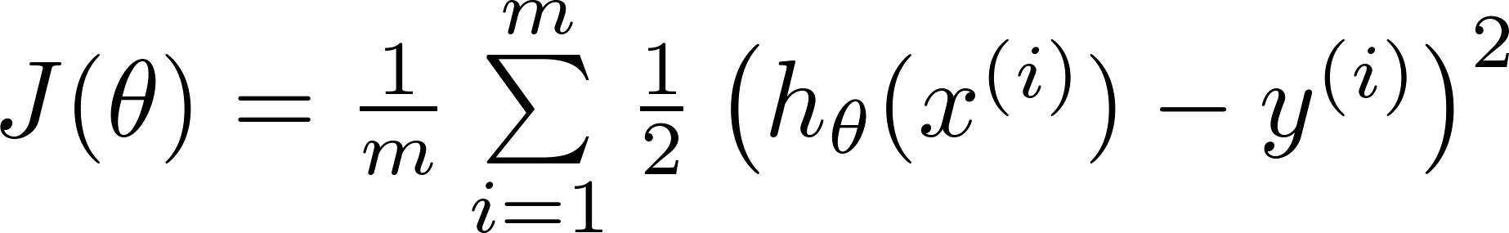

Cost function
Linear regression:
“non-convex”
“convex”

Slide 16
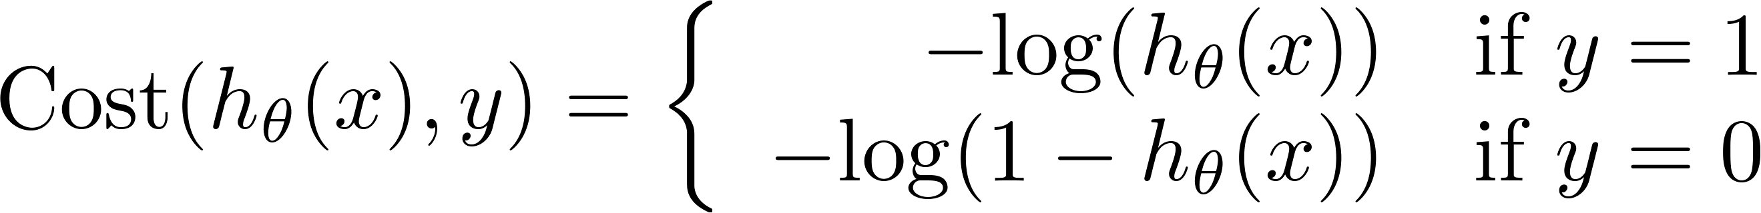
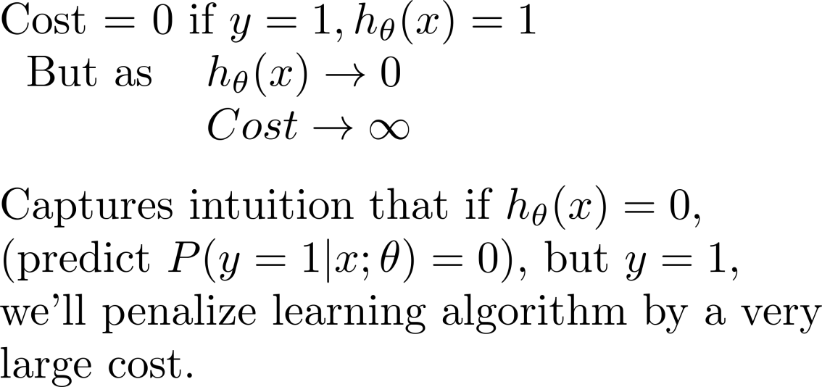
Logistic regression cost function
If y = 1
0
1

Slide 17
Logistic regression cost function
If y = 0
0
1

Slide 18
Cost Function and Gradient Descent
Logistic Regression

Slide 19
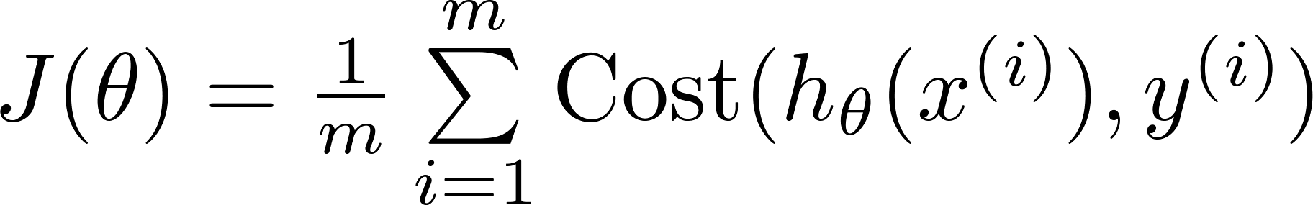
Logistic regression cost function

Slide 20


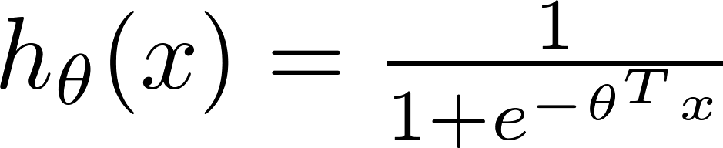
Logistic regression cost function
To fit parameters :
To make a prediction given new :
Output

Slide 21

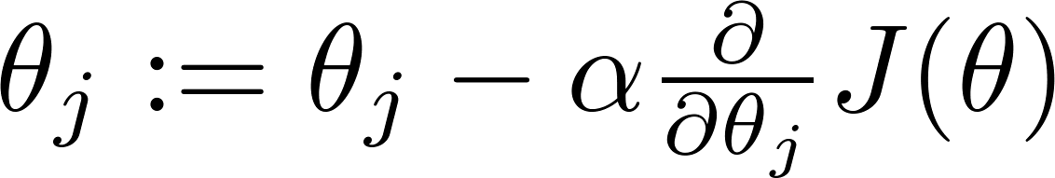

Gradient Descent
Want :
Repeat
(simultaneously update all )

Slide 22
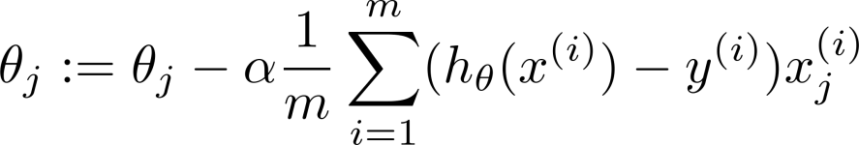
Gradient Descent
Want :
Repeat
(simultaneously update all )
Algorithm looks identical to linear regression!
Notes:
Derivative: http://math.stackexchange.com/questions/477207/derivative-of-cost-function-for-logistic-regression

Slide 23
Multi-class Classification One-vs-All
Logistic Regression

Slide 24
Multiclass classification
Email foldering/tagging: Work, Friends, Family, Hobby
Medical diagrams: Not ill, Cold, Flu
Weather: Sunny, Cloudy, Rain, Snow

Slide 25
Binary classification:
Multi-class classification:
x₂
x₂
x₁
x₁

Slide 26
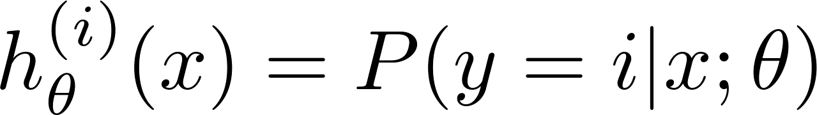

x₂
One-vs-all (one-vs-rest):
x₁
x₂
x₂
x₁
x₁
Class 1:
Class 2:
Class 3:
x₂
x₁

Slide 27
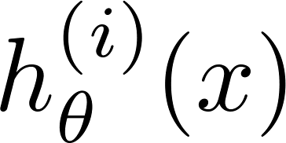

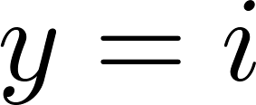

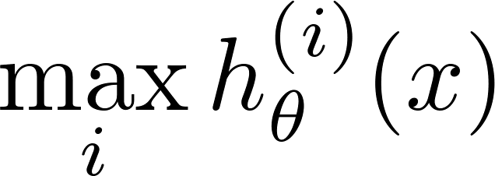
One-vs-all
Train a logistic regression classifier for each class to predict the probability that .
On a new input , to make a prediction, pick the class that maximizes

